Slide 1
Linguistic Fieldwork:
Two Case Studies
IDI
and
CHUVASH
Kate Lynn Lindsey
Stanford University

Slide 2
Linguistic Fieldwork: Two Case Studies
Introduction
Plan of Presentation
Documentation or Description?

Slide 3
Documentation of Idi
Boulder, CO
Summer 2011

Slide 4
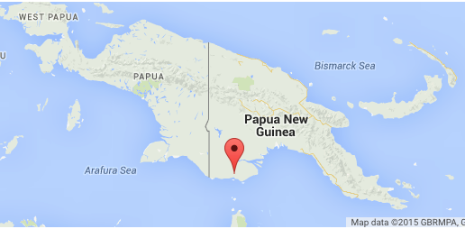
Idi Language
Idi means what
AKA Diblaeg, Dimisi, Dimsisi, Tame
Papuan language
Western Province, Papua New Guinea
1610 speakers
Literacy rate in L1: Below 5%. Literacy rate in L2: 50%
Language Status: 6a (Vigorous) - The language is used for face-to-face communication by all generations and the situation is sustainable.

Slide 5
Context
Wasang Baiio requested a documentation of his language
Nick Evans, who was working on neighboring Nen, brought him from PNG to Colorado for the LSA Institute in 2011
Ten students enrolled in the Field Methods class
Idi was unwritten, undocumented, unknown (to all, including Nick Evans)
Elicitation/analysis was done morning to night nearly every day of the institute
Results: lexicon (dictionary), sketch grammar, three texts

Slide 6
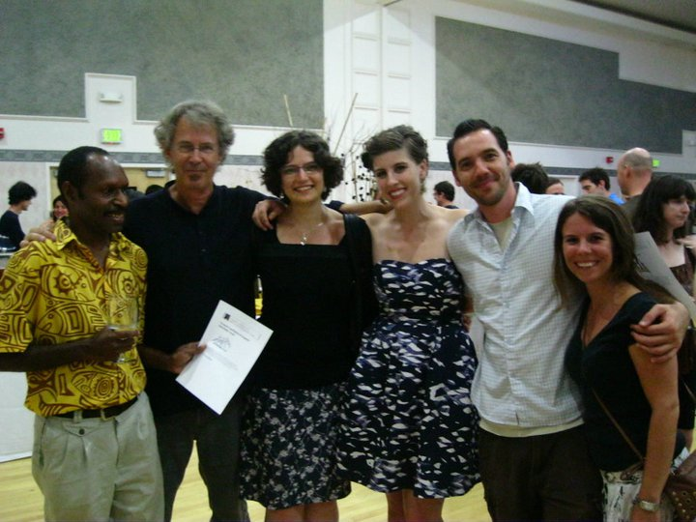
Part of the Field Methods Class
Wasang Baiio (Idi speaker) and Fieldworkers: Nick Evans, Oksana Tkachman, Kate Lindsey, Jorge Emilio Rosés Labrada, and Laura Zester.

Slide 7
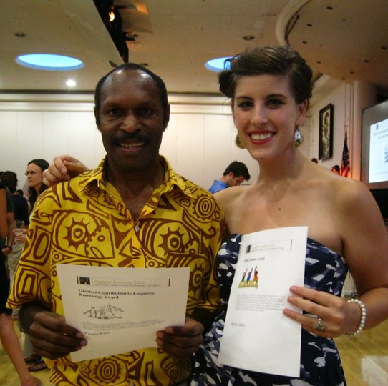
Wasang Baiio
Our consultant, Wasang Baiio, won the LSA Institute prize for “Greatest Contribution to Linguistic Knowledge”

Slide 8
Technology
Equipment
Software
Zoom Recorder
Boom condenser microphone
Laptops
Elicitation materials
Hardbound notebooks and pens
Back-up recorders
FLEx
  Lexical organization
  Morphological Parser
  Text organization
Elan
Praat
Lexique Pro

Slide 9
Our Workflow
Collection
Sound recording (.wav)
Official Notes (.pdf)
Elicitation Materials

Slide 10
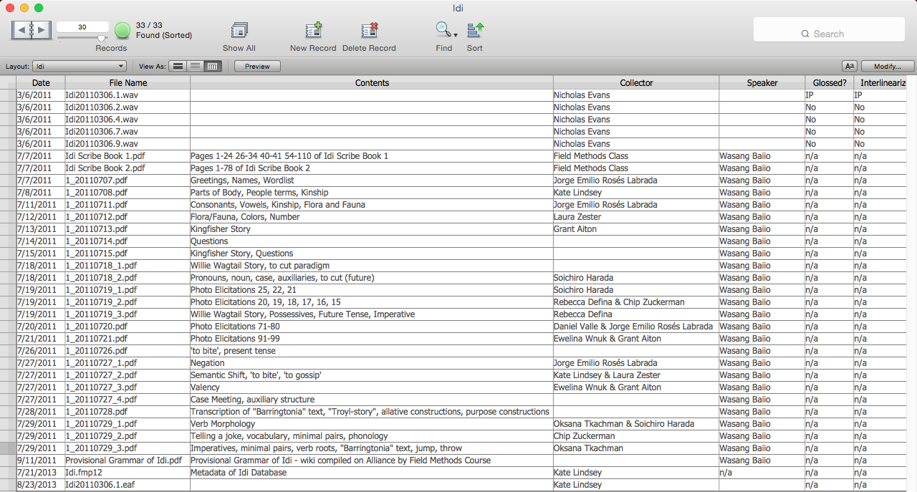
Metadata database

Slide 11
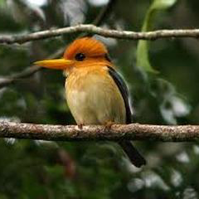
Example of a Recorded Text and elicitation Materials
Yarr (by Wasang Baiio)
Yare gle jén pa da ada gɭ walaŋgme néble walaŋgme dag walaŋgdume. La o məla niada walaŋgawa brndén o ʈəmŋgawa o do wəlaŋgme ne brndén o ʈəmŋgawa de bisi wəla gɭ yar ne méʎ bogen. Gəta adadada a da yəka de pendola a da idi qəɖle dwae dand o la jimi qəɖlira jén maema. Gəta dada yara pendola ni ʎiʎkwam wago. Gəta yəkadida pendanalə babom ʈona ada la jémi qəɖlira o yəka bisi walalo jén maeʈe. O jén la ŋaʈuŋ g̅édé qəɖélberən. Obene añka da irelu ne yara méʎ bogen, be gɭ waŋnoŋməndo dao qəɖél la bene añka. Eso debe.
Kingfisher Yar Text
Kingfisher (translation by Kate Lindsey)
The Kingfisher is another bird which you find in the forest and the tropical rain forest. When a man or woman goes to the forest or to the garden; they are in the forest or coming to the garden, when they hear the cry of the Kingfisher. It goes like this: this message reveals whether death is near or whether someone has died in another village. This is what the Kingfisher is saying when you get goose bumps. The information that the Kingfisher reveals is a message that a man has already died or that a message is coming from another village or that another man who has died long ago is near. His spirit is near and you will recall the spirit of the dead person. Thank you. The end.

Slide 12
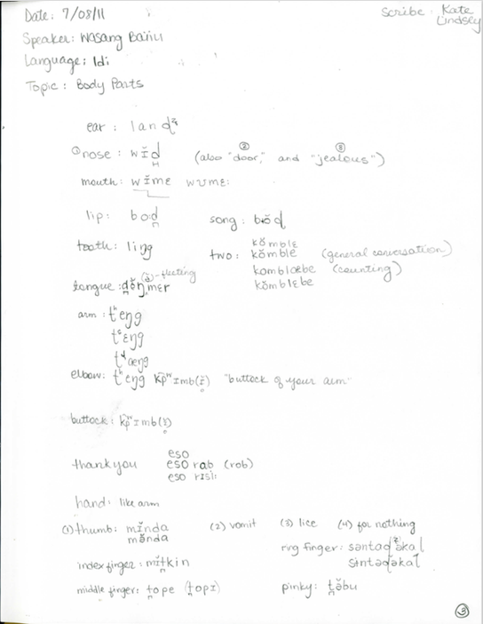
Example of our Field Notes

Slide 13
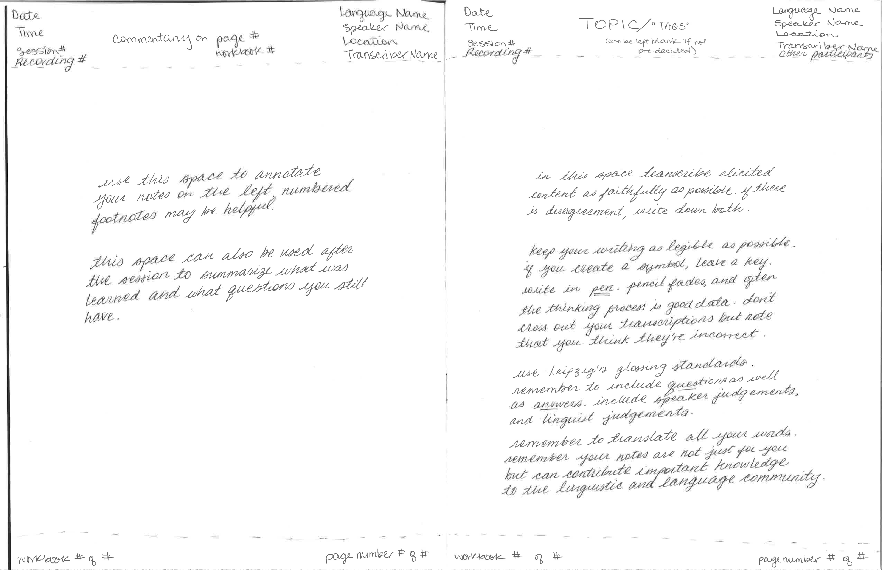
How to take good fieldnotes

Slide 14
Our Workflow
Lexicon
Morphological Analysis
Phonetic/Phonological Analysis
Texts
Syntactic Analysis
Praat, ELAN
FLEx, Lexique Pro
FLEx
ELAN, FLEx
FLEx

Slide 15
Challenges
Unnatural setting
  Brought pictures and artifacts from location where Idi is spoken
Exhausted speaker
  However, highly motivated as the team produced materials that he requested (lexicon, orthography, texts)
  Work was done in English
Limited time
  Only four weeks, which is why we worked morning-night
Limited access to speaker/documentation after Institute
  Wasang Baiio went back to PNG and all linguists returned to their home institutions
  Was the orthography implemented? Was the lexicon utilized? Was the analysis continued?

Slide 16
Description of chuvash
Chuvashia
AY 2012-13

Slide 17
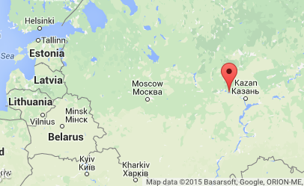
Chuvash Language
AKA Bulgar
Turkic language
Chuvashia, Russia
>1 million speakers (bilingual)
Newspapers, Radio programs, TV, Dictionary, Grammar, Bible
Language Status: 4 (Educational) - The language is in vigorous use, with standardization and literature being sustained through a widespread system of institutionally supported education.
However, attitudes toward the language are very poor. Intergenerational transmission only in villages.

Slide 18
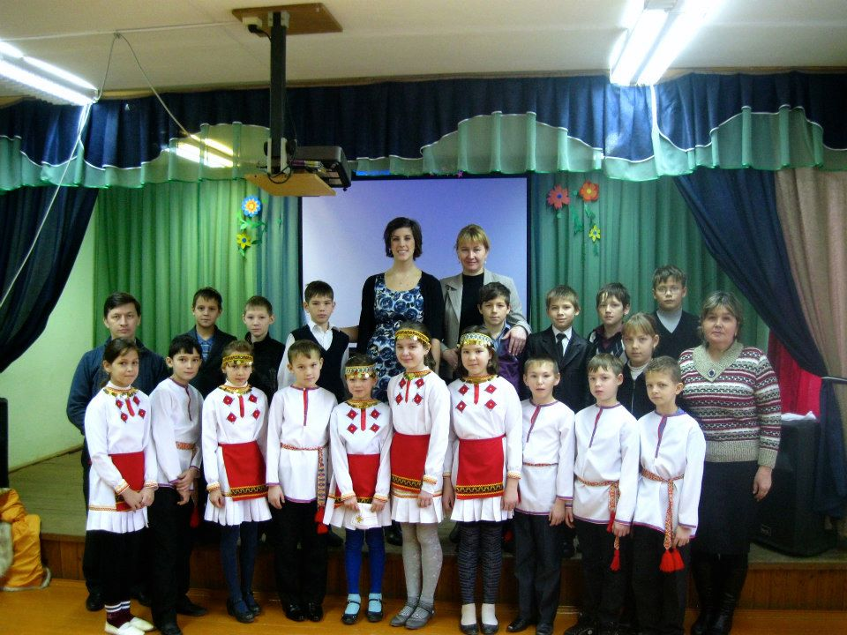
Chuvash speakers and school children
Village Elementary School in Chuvashia

Slide 19
Context
Kate Lindsey initiated contact with the community
Academic focus:
  piloting two tools to measure language dominance
  gather specific recordings for phonetic/phonological analysis
One linguist, data from more than 100 speakers
Chuvash is written, documented, has extensive literature
Elicitation/analysis was conducted as speakers were found
Found speakers through word-of-mouth and through volunteering time at Chuvash elementary schools
Results: psycholinguistic analysis of language dominance, phonetic analysis of vowels, phonological analysis of foot structure
  Use to community?

Slide 20
Technology
Equipment
Software
Zoom Recorder
Head/lapel microphone
Laptop
Elicitation materials
Hardbound notebooks and pens
Back-up recorders
HALA (experiment)
BLP (survey)
Praat
Microsoft Excel
SPSS Statistics

Slide 21
Workflow
Meet speaker
HALA experiment
BLP experiment
Text elicitation
Volunteer in community
Ask if they know another speaker
Transcription/analysis/data management whenever possible

Slide 22
Challenges
Unnatural experiment
  Speakers were not accustomed to tasks on the computer that were timing-sensitive (answer as quickly as possible) or individual (don’t whisper the answers to one another)
Exhausted linguist
  I went to each speaker’s village/house/nearby café/library, instead of them coming to me. Nearly every village requested a school visit, English presentation, Chuvash presentation, dinners with village leaders, overnight stays.
  Work was done in Russian
Limited use of resulting materials
  Analysis of language dominance was submitted to (and hopefully used by) government officials
  Gave back in other ways
    Used “American prestige” to advertise Chuvash language classes in capital
    Funded Chuvash language summer camp
    Gave countless presentations in English/Chuvash at elementary schools
    Gave countless newspaper/radio/TV interviews on state of Chuvash lg.

Slide 23
Let’s Compare
Idi
Chuvash
Focus on collection
Unnatural setting
“Community”-directed
Useful results
Exhausted speaker
Limited connection to community
Focus on analysis
Natural setting
Linguist-directed
Marginally useful
Exhausted linguist
Extensive connection to community

